Slide 1
#android #unit-testing
Robolectric Adventure v.2

Slide 2

Agenda
Different types of testing
How does Robolectric work?
How to write Robolectric tests?
Q&A

Slide 3

How to check the bicycle?

Slide 4

How to check the chain transmission?

Slide 5

How to check the ball bearing?

Slide 6
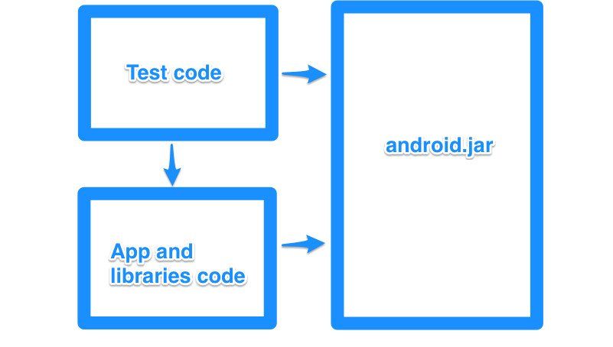
android.jar
V
X
V
V
X
java.lang.RuntimeException: Stub!

Slide 7
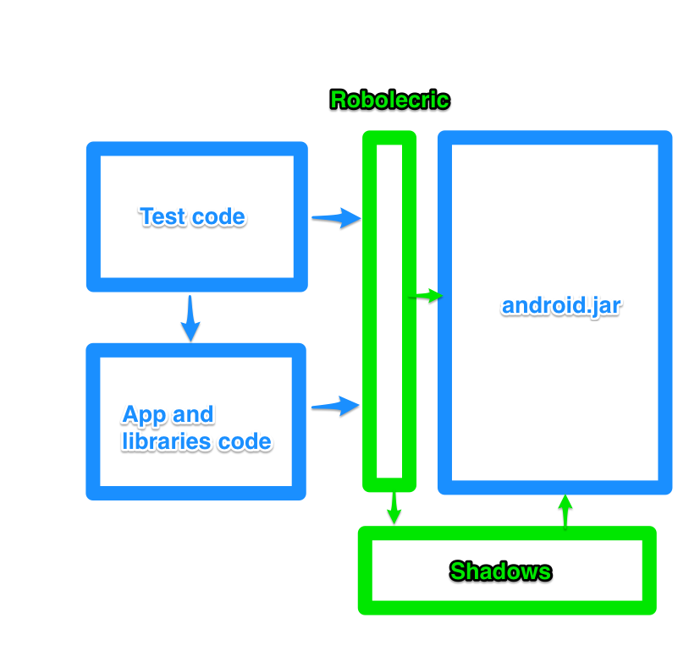


Shadowing
AOSP

Slide 8
In addition
Resource loading
Controlling main and background loopers
Access for private state for Android classes
Test application

Slide 9
Run first test
Modify build.gradle
Add test runner with configuration
Write test code
Run grade

Slide 10
build.grade
buildscript {
depednencies {
classpath 'org.robolectric:robolectric-gradle-plugin:1.0.1'
}
}
apply plugin: 'org.robolectric'
dependencies {
testCompile 'junit:junit:4.12'
testCompile 'org.robolectric:robolectric:2.4'
}

Slide 11
Test
@RunWith( RobolectricTestRunner.class )
@Config( emulateSdk = 19 )
public class AboutActivityTest
{
private AboutActivity activity;
@Before
public void setUp()
{
activity = Robolectric.buildActivity( AboutActivity.class ).create().get();
}
@Test
public void copyrightYearIsCorrect()
throws Exception
{
int year = Calendar.getInstance().get( Calendar.YEAR );
String text = String.format(
activity.getString( R.string.Copyright_Minddistrict ),
year
);
assertThat( activity.copyrightText ).hasTextString( text );
}
}

Slide 12
AssertJ/FestAssert
assertThat(view).isGone();
vs
assertEquals(View.GONE, view.getVisibility());
Expected visibility <gone> but was <invisible>.
vs
expected: <8> but was: <4>

Slide 13
Behaviour test
public class LoginActivity
extends ActionBarActivity
{
User user;
@InjectView( R.id.email_address )
EditText emailField;
@InjectView( R.id.password )
EditText passwordField;
@OnClick( R.id.button_login )
public void login()
{
if ( validateForm() )
{
user.startDiscovery( emailField.getText().toString(),
passwordField.getText().toString() );
}
}
}

Slide 14
Mockito
public class LoginActivityTest
{
private static final String EMAIL = "test@gas.com";
private static final String PASSWORD = "pass";
LoginActivity activity;
@Test
public void whenLoginStartedThenUserCalled()
throws Exception
{
activity.emailField.setText( EMAIL );
activity.passwordField.setText( PASSWORD );
User user = mock( User.class );
activity.user = user;
activity.login();
verify( user ).startDiscovery( EMAIL, PASSWORD );
}
}

Slide 15
Test application
<application android:name=".FooApplication">
public class FooApplication
extends Application {
@Override
public void onCreate() {
super.onCreate();
// Dependency injection init
// Analytics setup
// ORM configuration
}
}
public class TestFooApplication
extends FooApplication {
@Override
public void onCreate() {
super.onCreate();
// Surpress ORM
// Configure test injections
// Disabling analytics
}
}

Slide 16
Future
Android gradle plugin 1.1
Easy tests in Android Studio
Robolectric 3.0

Slide 17
References
Answers about different types of testing (http://www.quora.com/What-is-the-difference-between-unit-testing-functional-testing-and-integration-testing)
Talk about how Robolectric works (http://pivotallabs.com/mike-grafton-robolectric/ )
Sample project how setup Robolectric, Android Studio and android grade plugin (https://github.com/nenick/AndroidStudioAndRobolectric)
Robolectric github page (https://github.com/robolectric)
Robolectric official web page (http://robolectric.org/)
My twitter for any question or help (@jack_martynov)

Slide 18
Thank you!
Any question?

